Slide 1


Asia Pacific College
Disaster Response
Bueno | Belchez | Malapo | Moreta

Slide 2
Law and Order
Bueno | Belchez | Malapo | Moreta

Slide 3
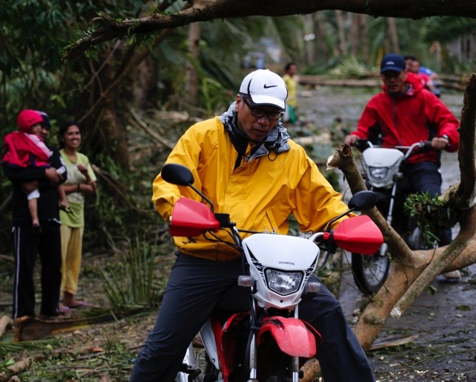

Law and Order
MISSION: To ensure that peace and order will be upheld during disaster
LEAD AGENCY: Philippine National Police

Slide 4
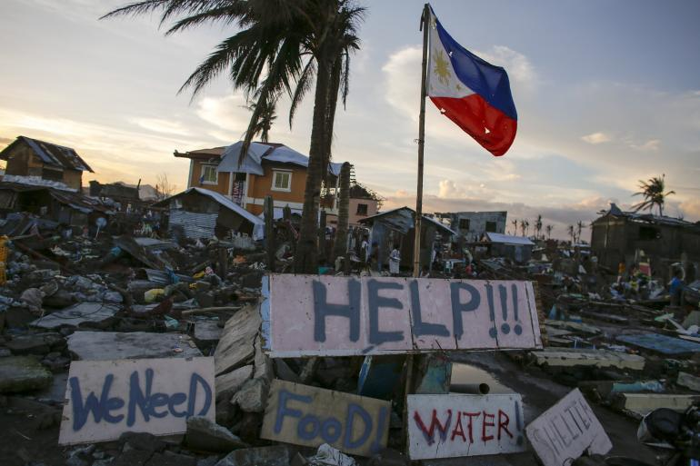
Scope
Maintains peace and order.
Provides support on a disaster.
Monitors the area covered that has been reported.

Slide 5
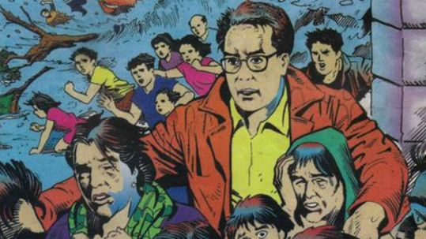
Provides the following:
Security
Accountability
Accessibility
Support to response
Recovery
Rehabilitation

Slide 6
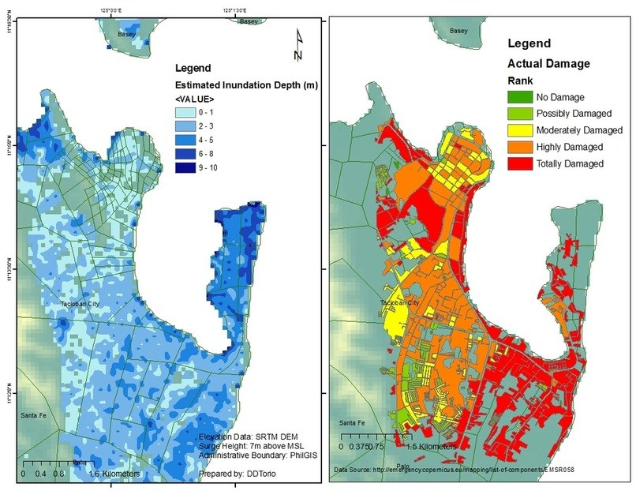
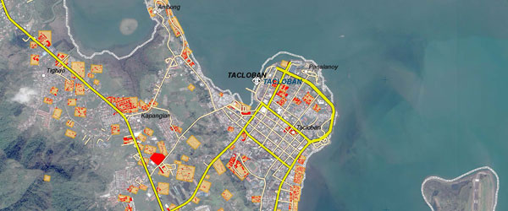
Level of Disaster

Slide 7





MEMBER AGENCIES:
AFP,DFA, OCD, DILG, DOH, MMDA, REACT, NBI, PRC, PNP, BFP, DPWH, PCG, IFRC, ICRC, UNDAC and Private / Volunteer Groups

Slide 8
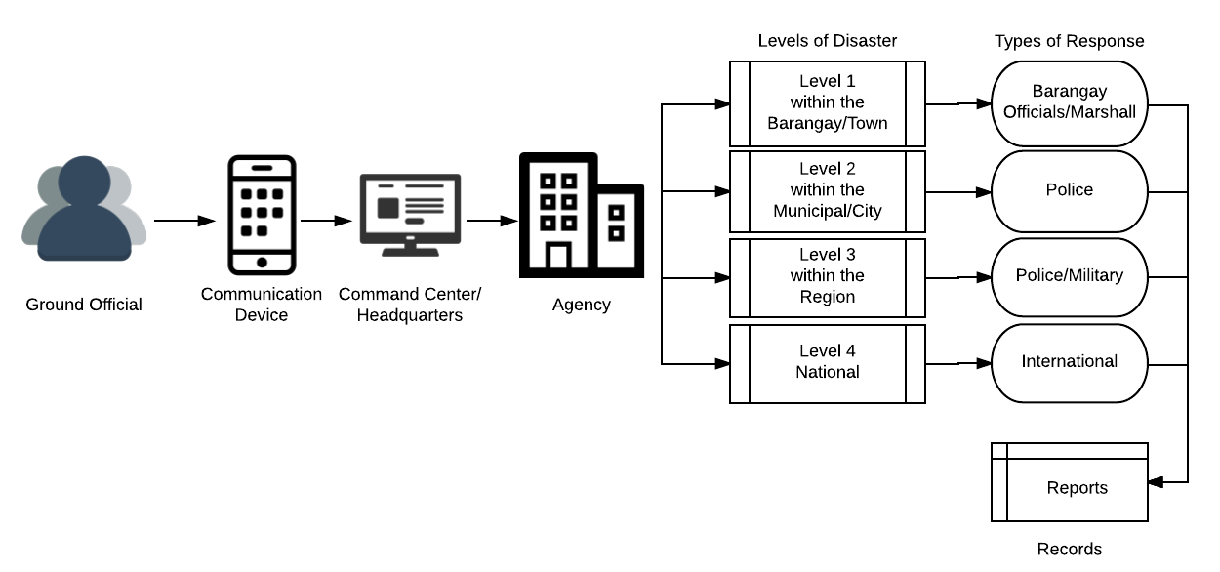
Conceptual Framework Diagram

Slide 9
Education
Bueno | Belchez | Malapo | Moreta

Slide 10

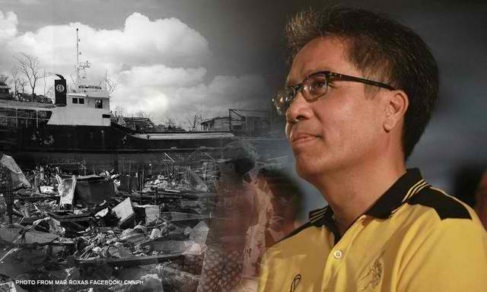
Education
MISSION: To ensure safety of learners and DepEd personnel and to provide continued access to quality of education to all affected learner.
LEAD AGENCY: DEPARTMENT OF EDUCATION

Slide 11
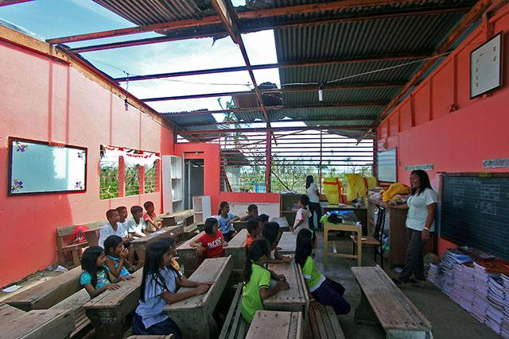
Objectives
Creates reports on the affected students and schools.
Provides a recovery program for the students and school officials affected.
Supports the recovery of the school’s infrastructures.
Identify the cost of damage and time for recovery.

Slide 12




MEMBER AGENCIES:
TESDA,DOH, DPWH, MGB, DSWD, PRC, UNICEF, Save the Children, Plan International, World Vision, Private and Volunteer Groups acknowledged by NDRRMC

Slide 13
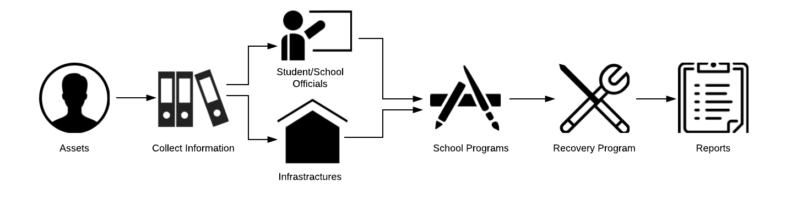
Conceptual Framework Diagram

Slide 14

Resources

Slide 15
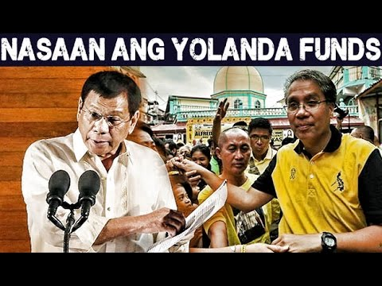
Law and Order | Education

